Slide 1


Creating, Publishing and Reusing an Oracle JET Composite Component
Lucas Jellema, CTO of AMIS
nlOUG Tech Experience 2018, Amersfoort, The Netherlands
Notes:
Lucas Jellema Developer Champion (NL)
Parallel session 3.5b Intermediate
Creating, Publishing and Reusing a JET Composite Component [25 min]
Composite Components are a crucial element in the evolution of Oracle JET. These components allow organizations to better structure their enterprise applications built with JET and to introduce efficiency and UX consistency through reuse UI components. JET Composite Components are also shared across the boundaries of enterprises, throughout the community, to be consumed in JET applications anywhere and in Visual Builder Cloud applications. This session demonstrates how a JET Composite Component is designed and implemented. The component introduces a Geographical Map on which data bound locations (regions, countries, states and cities) can be indicated and selected. The component supports two way data binding, configuration properties and it publishes events. It leverages open source map and geocoding libraries. This session demonstrates how the component is packaged and published and how it can be reused in a JET application as well as in Visual Builder Cloud. It will allow you to start reusing, building and publishing your own JET Composite Components.

Slide 2

Lucas Jellema Architect / Developer 1994 started in IT at Oracle 2002 joined AMIS Currently CTO & Solution Architect

Slide 3
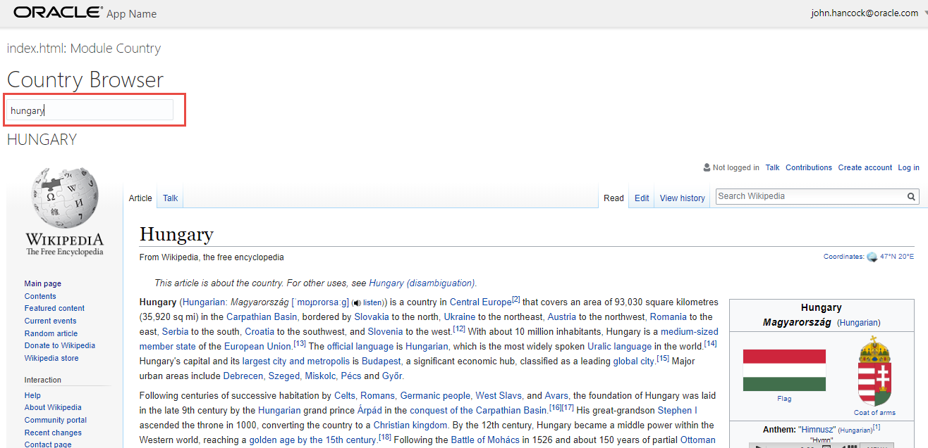
Country Browser - with room for UX improvement

Slide 4
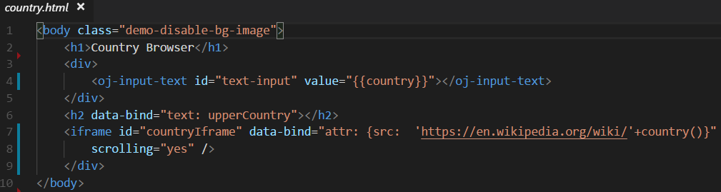
Country Browser - with room for UX improvement

Slide 5
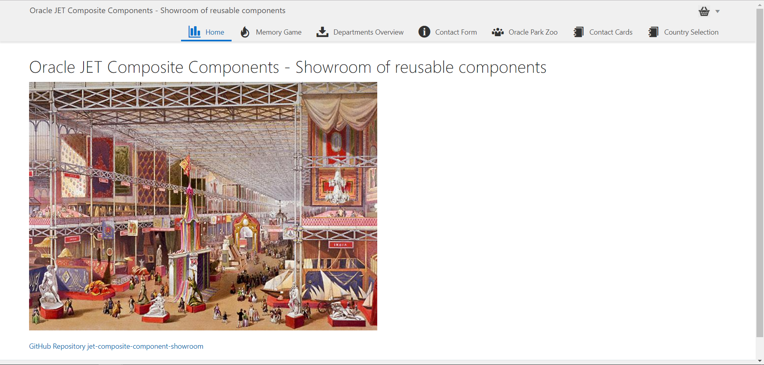

Slide 6
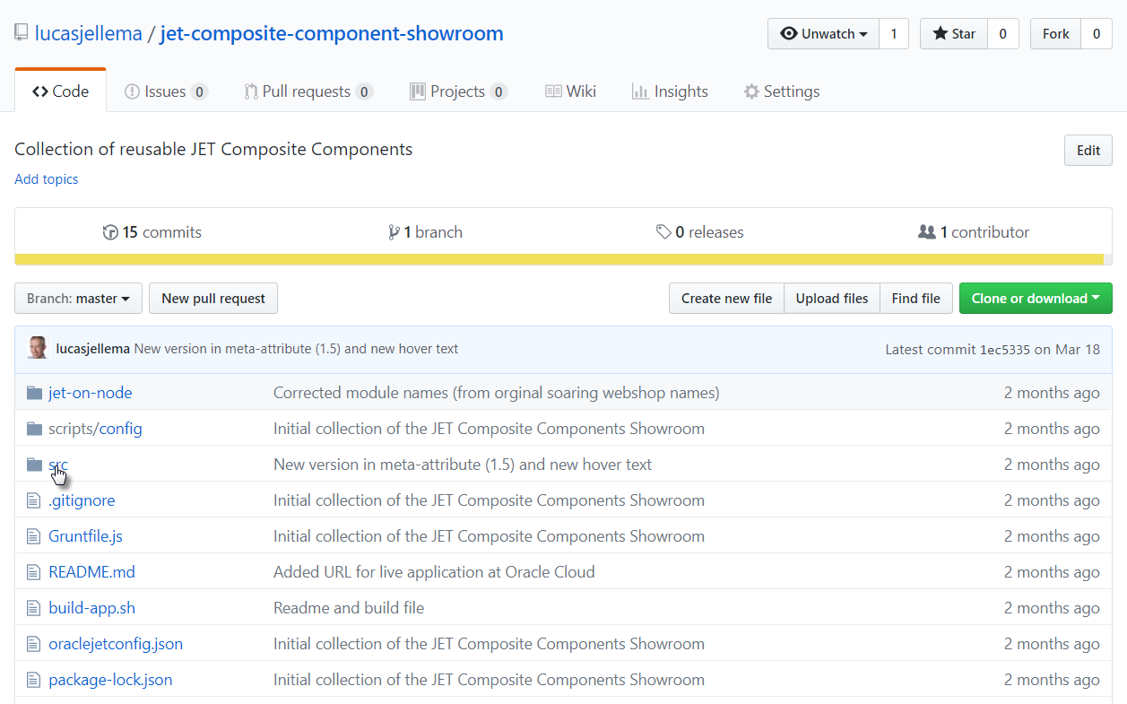
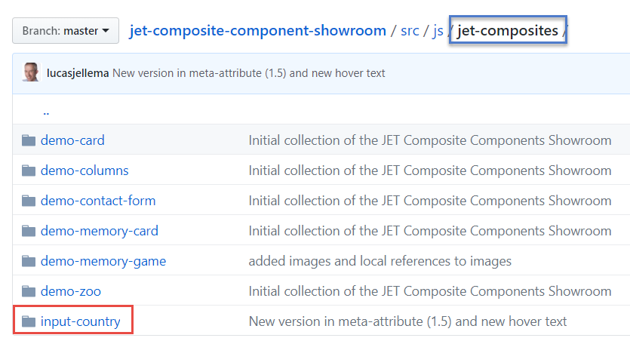

Slide 7
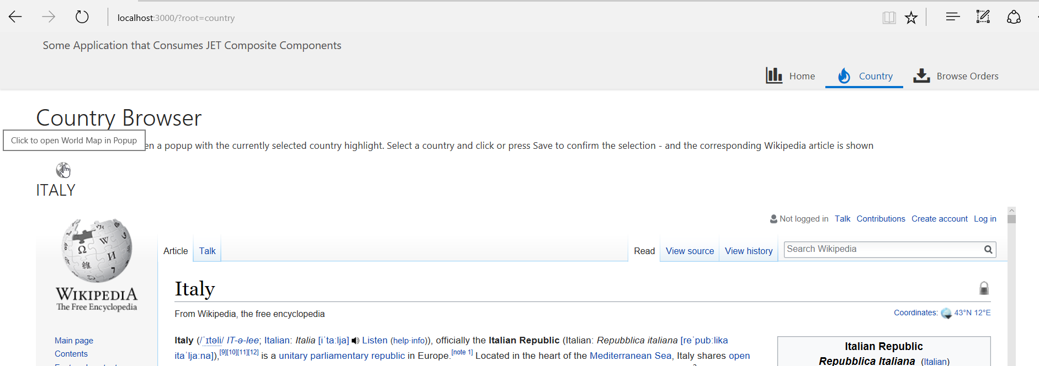
Wikipedia Country browser powered by JET Composite Component
Notes:
hhhhhhhhhhhhh6hhhhhhhhh6hh6h6h6hhh6hhhh6hhhhh6hhh66h66hhh6h6h6hh66hh6h

Slide 8
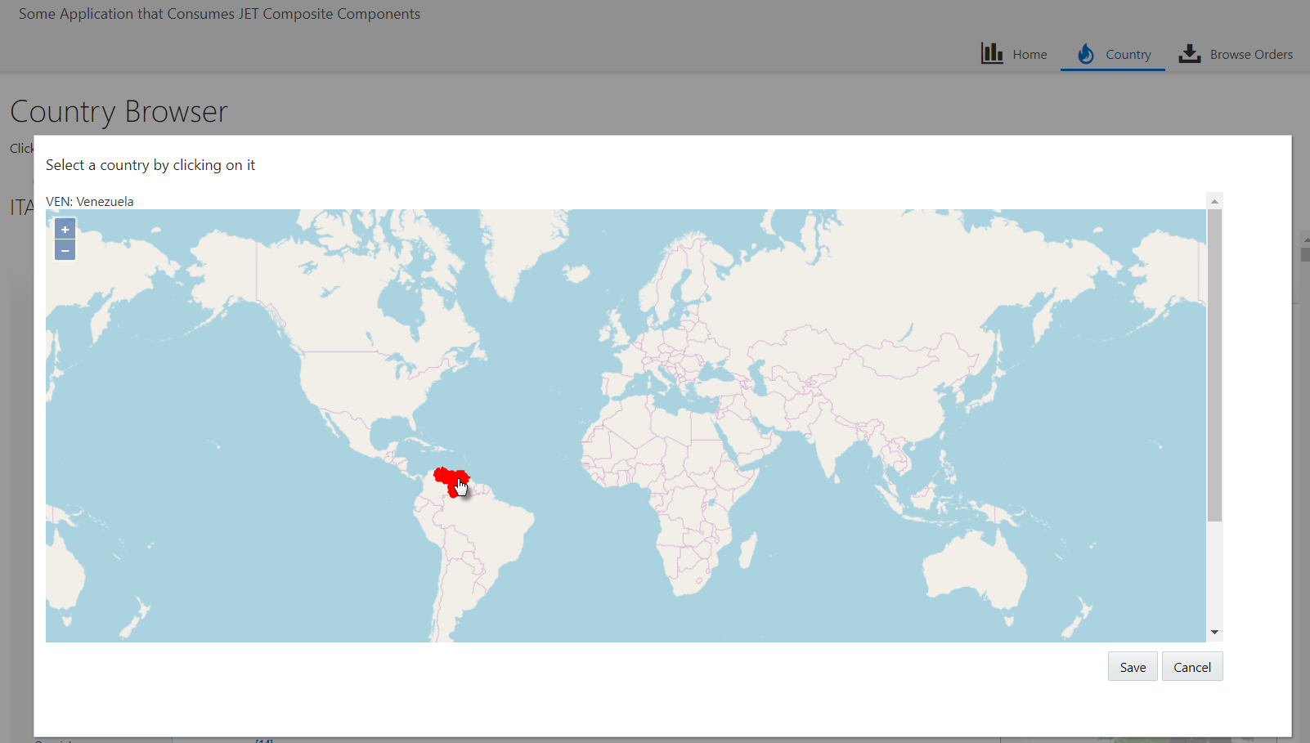
Click on country and select another country to inspect in Wikipedia

Slide 9
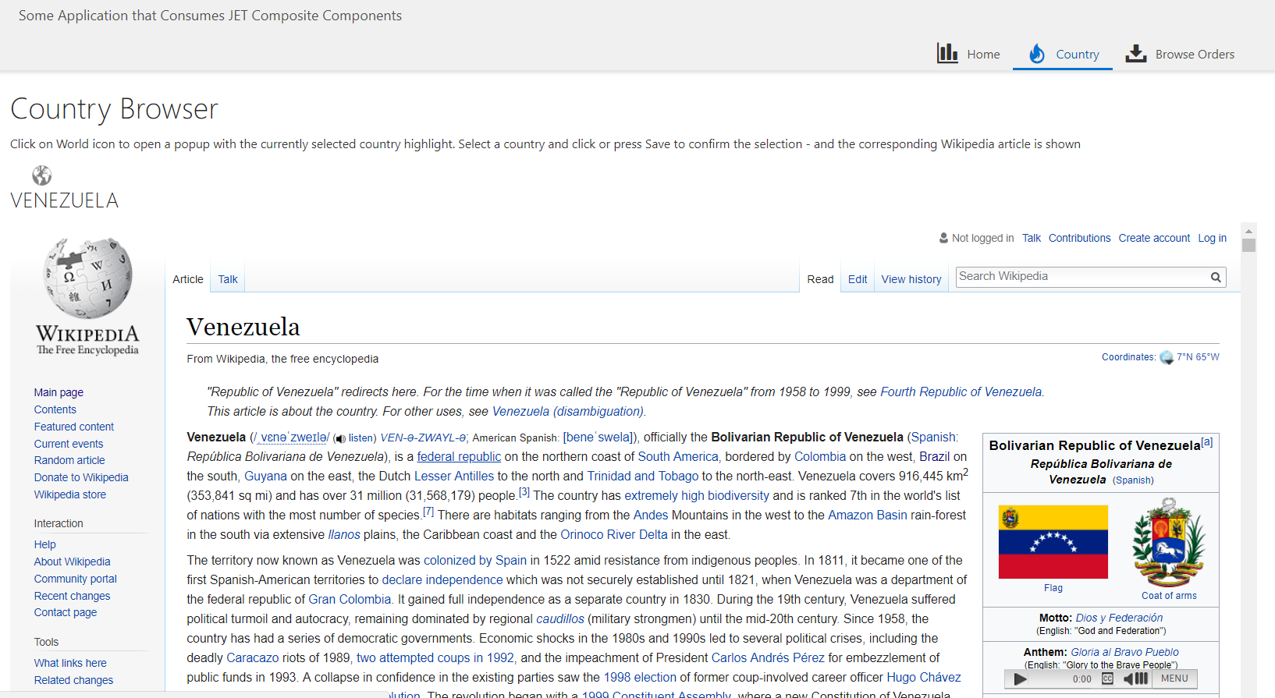
Wikipedia details for newly selected country are shown in an IFRAME

Slide 10
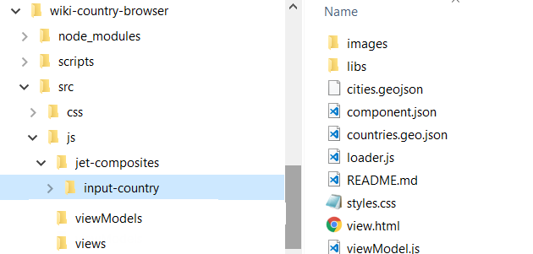
Copy JET Composite Component into application

Slide 11
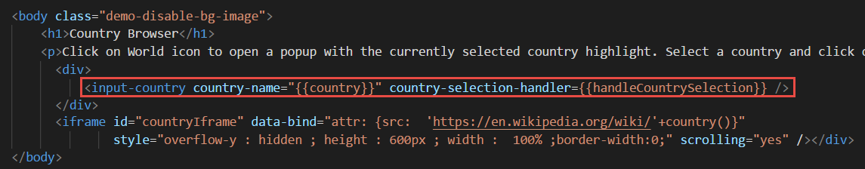
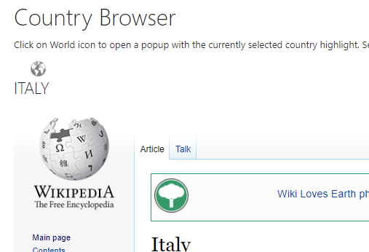
Embedding input-country component in view:

Slide 12
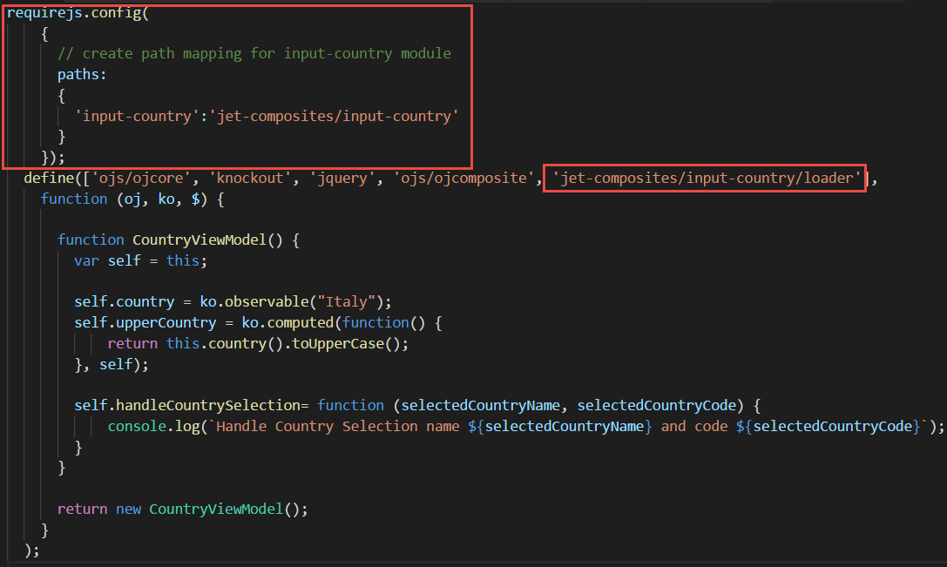
ViewModel – require & define to hook component into page

Slide 13

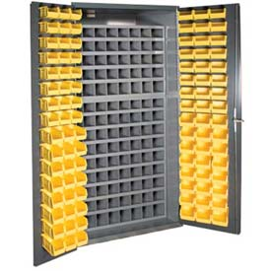

Beauty of Composite Components
Notes:
Share & Reuse
Internally within an application as well as throughout organization
Externally across the community
Compartmentalize development effort – make smaller, stand alone pieces
Micro….
Bonus: low code extension

Slide 14
Introducing JET Composite Component Architecture (CCA): “A composite component is a reusable piece of UI that can be embedded as a custom HTML element and can be composed of other composites, JET components, HTML, JavaScript, or CSS.”
Notes:
http://www.oracle.com/webfolder/technetwork/jet/jetCookbook.html?component=composite&demo=basic

Slide 15
JET Composite Component
A reusable building block – encapsulated with a well defined interface
Created using HTML, CSS, JavaScript, JET resources, other CCA components
Packaged in a Zip file that can be shared with any application and any team
Easily ‘injected’ into a JET application
copy contents of zip-file to specific directory
And easily used in a page
Add tag to View
Load module in ViewModel
JET CCA
InputSmiley
My JET Application
Your JET Application
Page 1
Page 2
JET CCA
InputSmiley
JET CCA
InputSmiley
Page A
Page B
<input-smiley>
<input-smiley>
<input-smiley>
<input-smiley>
<input-smiley>
<input-smiley>
<input-smiley>

Slide 16
Constitution of a JET Composite Component
JET CCA
Component
UI (HTML + CSS)
Events, Property Updates, Function calls

Slide 17
Constitution of a JET Composite Component
JET CCA
Component
UI (HTML + CSS)
loader.js
view.html
Events, Property Updates, Function calls
component.json
styles.css
Other Resources
viewModel.js

Slide 18
Constitution of a JET Composite Component
Property values (can be Observables and callback functions), Function Calls
JET CCA
Component
UI (HTML + CSS)
loader.js
view.html
Events, Property Updates, Function calls
component.json
styles.css
Other Resources
viewModel.js

Slide 19
Creation of a component
Identify scope of the component
Create a regular JET application (ojet)
Generate a composite component (ojet)
Identify and separate two areas
Test bed, sandbox – used for development & test
Composite Component
Iteratively
Configure & Describe
Develop
Test
Publish ( => Consume – many times)
ViewModel
Composite Component
View
Sandbox JET Application

Slide 20
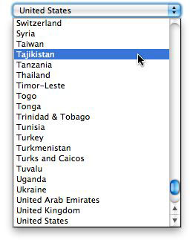
Develop Input Country Component
Scope: display and select country on a map
Zoom, pan, ..
To be used instead of these horrible dropdown lists
Later: possibly extend with
multiple countries
Regions, cities

Slide 21
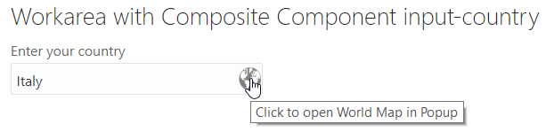
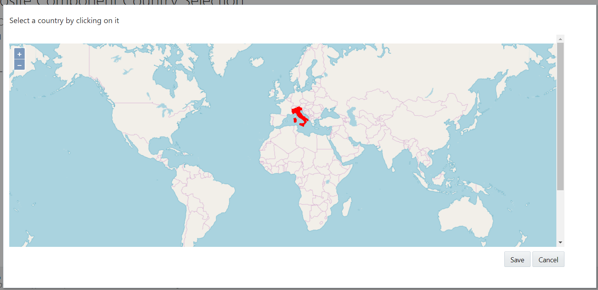

Slide 22
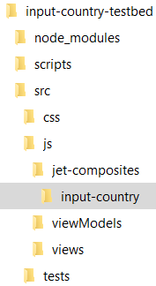
Input Country
Create a regular JET application input-country-testbed
Generate Composite Component input-country
Identify and separate two areas
Test bed– used for development & test
Composite Component
Iteratively
Configure & Describe
Develop
Test
Publish
ViewModel
input-country
Composite Component
publish
View
input-country-testbed

Slide 23
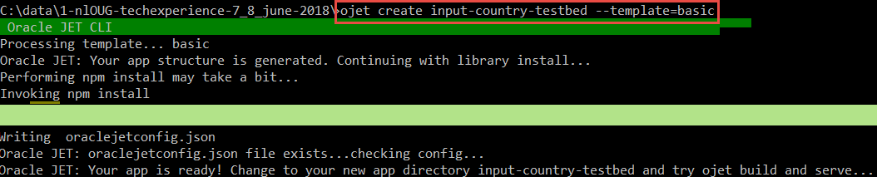
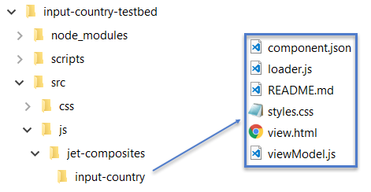
Generate Sandbox JET application and the skeleton JET Composite Component

Slide 24
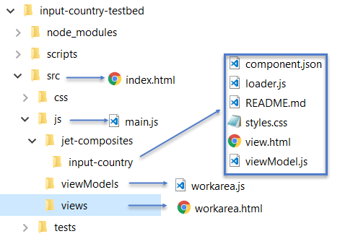
Prepare test bed
Create directory src/js/views
And file workarea.html
Including the <input-country> tag
Create directory src/js/viewModels
And file workarea.js
With references to composite component input-country
Include reference to module workarea in index.html
Include reference to ojModule in main.js
Run testbed application with ojet serve

Slide 25
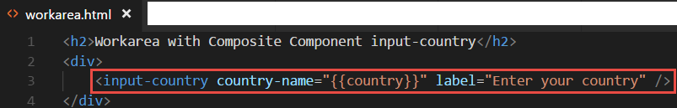
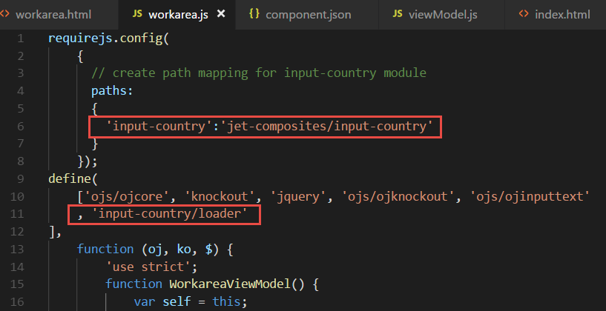
Prepare test bed
Workarea.html
Including the <input-country> tag
Workarea.js
With references to composite component input-country

Slide 26
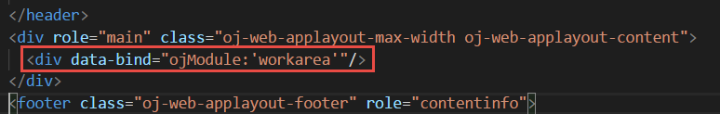
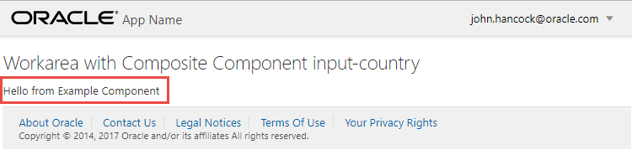
Prepare test bed
Include reference to module workarea in index.html
Include reference to ojModule in main.js
Run testbed application with ojet serve

Slide 27
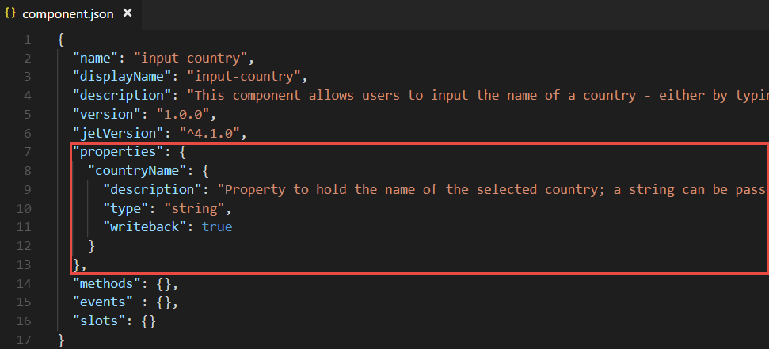
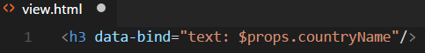
Define a property for the component and make it display something
Define property countryName in component.json
Use value of property in output rendered by the component

Slide 28
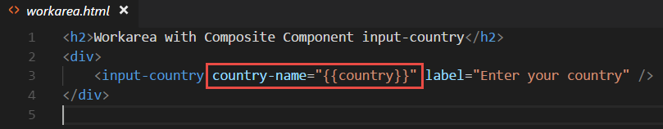
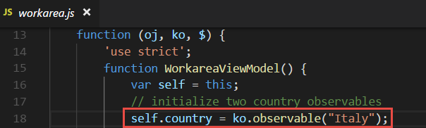
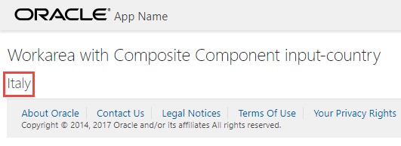
Set property in test bed application

Slide 29

Show world map with country highlighting & selection
Notes:
Leverage the world wide community

Slide 30
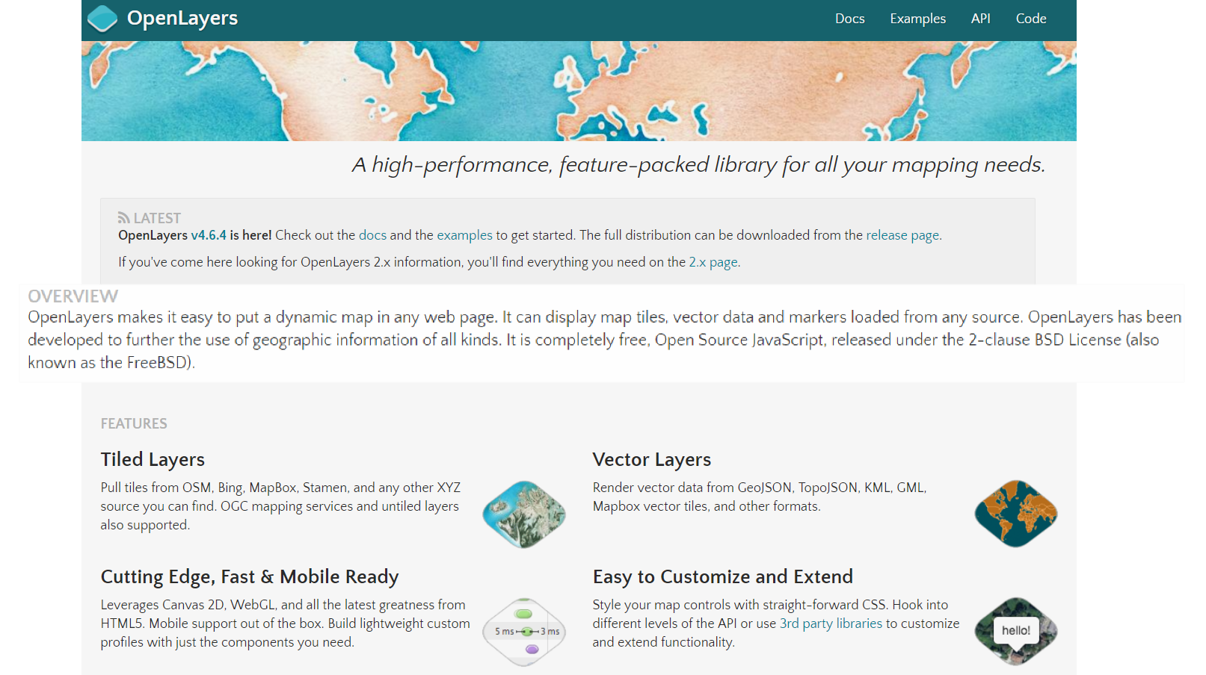
Introducing OpenLayers (open source, HTML5, JavaScript)
Notes:
Examples: http://openlayers.org/en/latest/examples/
API: http://openlayers.org/en/latest/apidoc/
Quickstart: https://openlayers.org/en/latest/doc/quickstart.html
On Line Editor: http://programmerg.github.io/ol3editor/

Slide 31

OpenLayers - Summary
Initial release: 2006
Most recent release: 4.6.5, March 2018
Since 2007 under Open Source GeoSpatial Foundation (OSGeo)
Originally based on Prototype JavaScript Framework; still fully (client side) JavaScript
Support for GeoRSS, KML (Keyhole Markup Language), Geography Markup Language (GML), GeoJSON and map data from any source using OGC-standards as Web Map Service (WMS) or Web Feature Service (WFS).
Map sources include Bing, Open Street Map, MapBox, Stamen, ArcGis (Esri)
Notes:
https://en.wikipedia.org/wiki/OpenLayers
https://en.wikipedia.org/wiki/Open_Source_Geospatial_Foundation
https://en.wikipedia.org/wiki/OpenStreetMap
Sites using OpenLayers: https://www.wappalyzer.com/technologies/openlayers

Slide 32
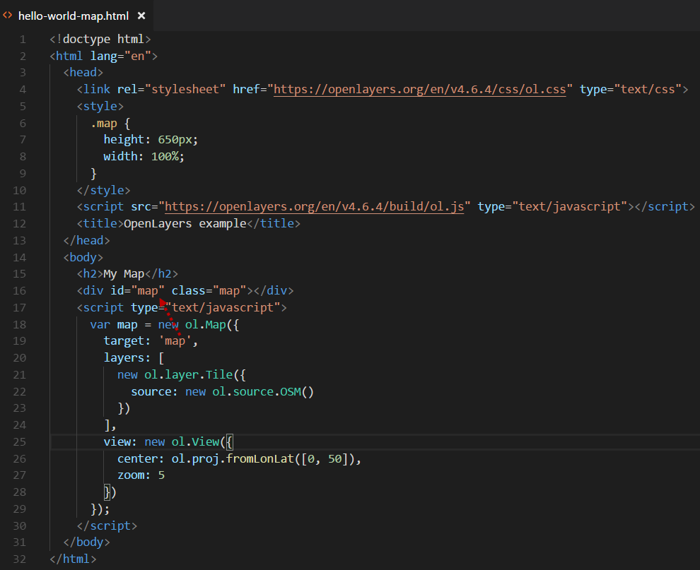
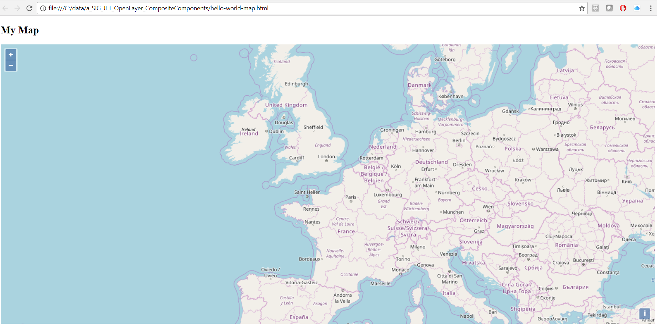
Hello World Map
Notes:
https://openlayers.org/en/latest/doc/quickstart.html

Slide 33
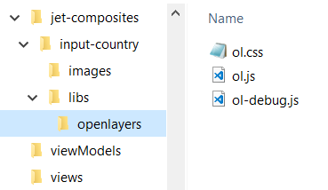
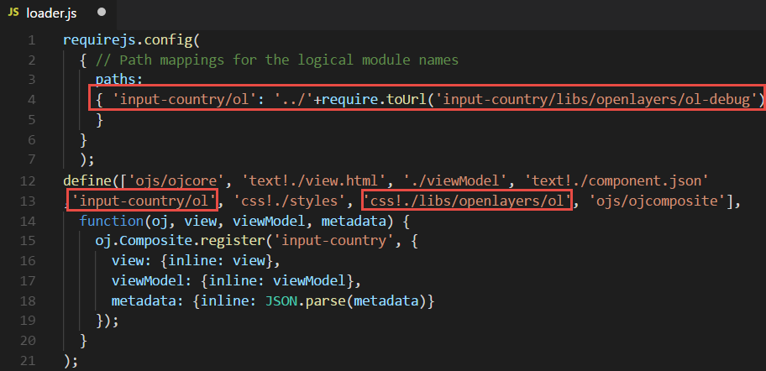
Add OpenLayers to JET Composite Component
Copy OpenLayers libraries into jet-composites/input-country/libs
Include OpenLayers resource in loader.js

Slide 34
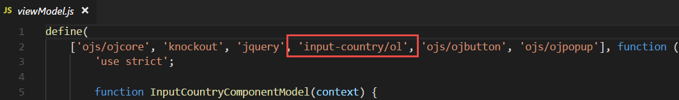
Add OpenLayers to JET Composite Component (2)
Reference module input-country/ol in viewModel.js in order to leverage the OpenLayers JavaScript objects

Slide 35
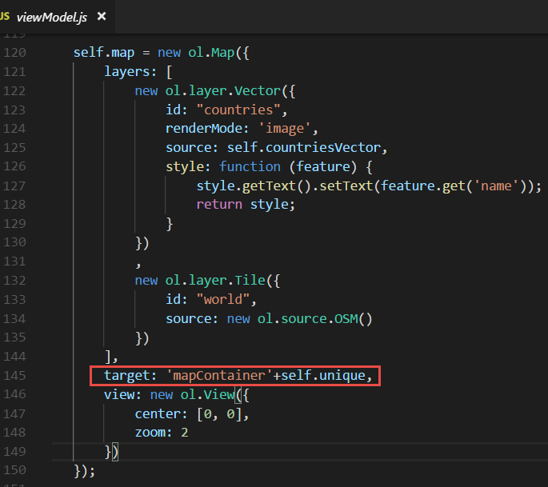
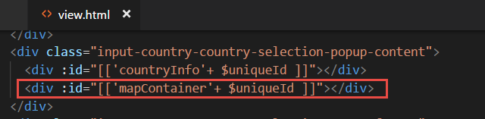
Show OpenLayers map in Composite Component

Slide 36
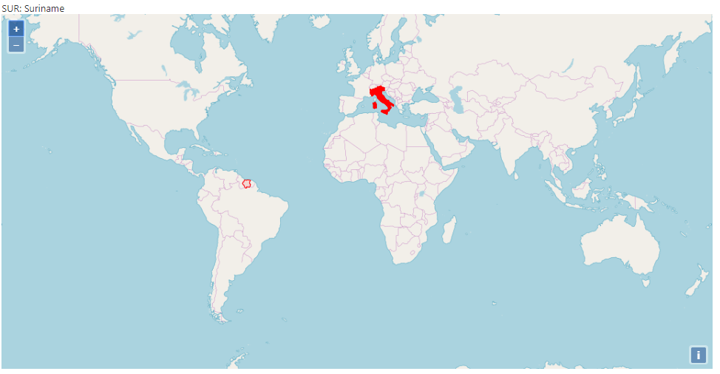

Slide 37
Output from a Component
UI (HTML + CSS)
JET CCA
Component
Property values (can be Observables and callback functions), Function Calls
Set Observable, Callback function
Events, Property Updates, Function calls
(be inspected from the consuming application)
(publish event explicitly on client side event bus)

Slide 38
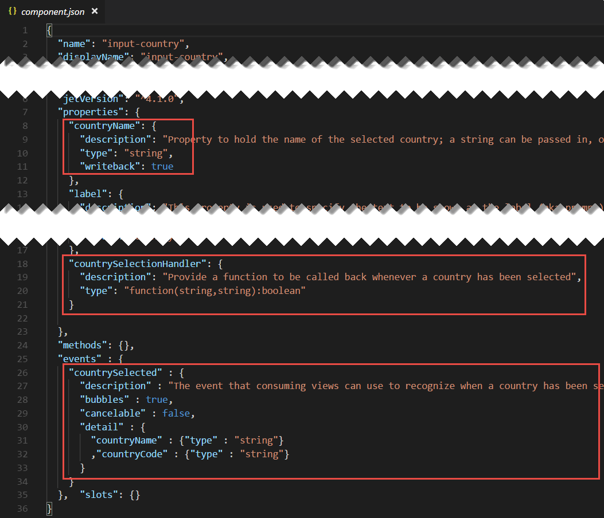
Define component output in component.json
Writable property
Callback function
Event

Slide 39
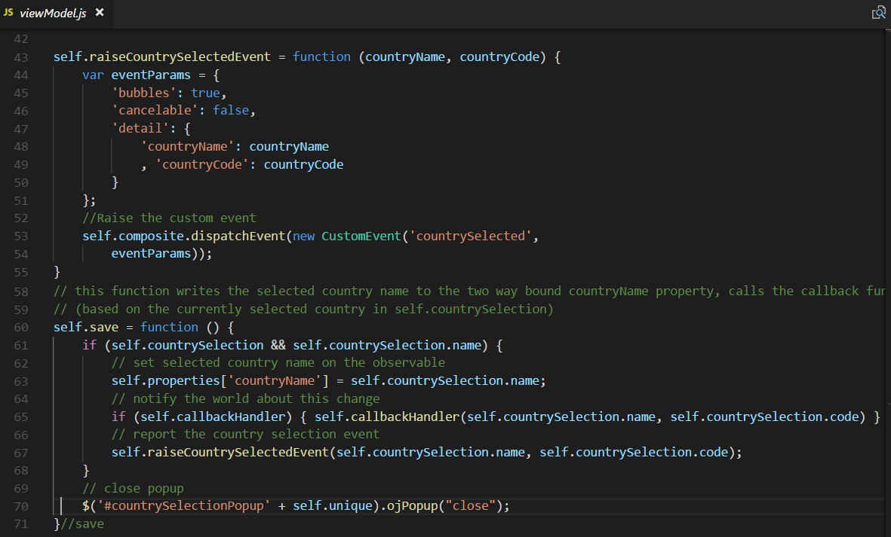
Publish output from input-country component
Publish Event
Set writable property
Invoke Callback function

Slide 40
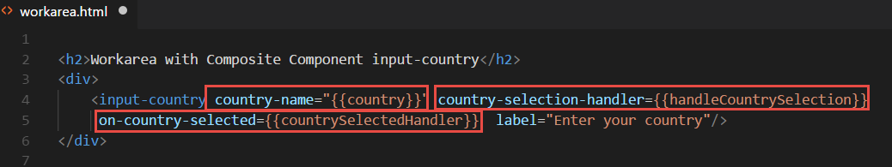
Leverage output in consuming application
Callback function
Observable, writable property
Event Handler

Slide 41
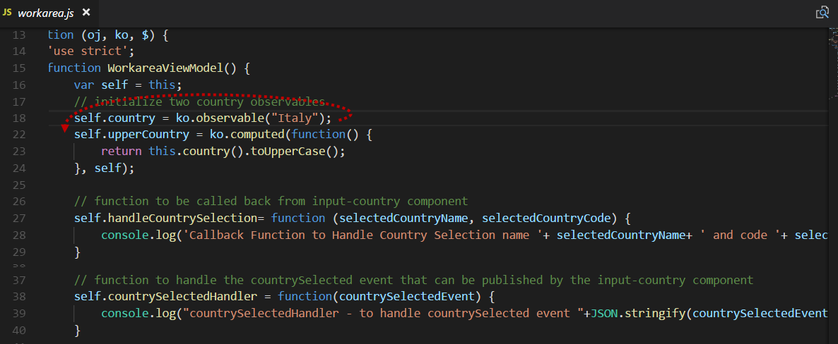
Handling Component Output in Consuming Application
Observable, writable property
Callback function
Event Handler

Slide 42
Consume a JET Composite Component in your own application
Unzip the zip-file to the src/js/jet-composites directory in the target JET project
Add a reference to the component’s loader in the define() call in the viewModel for each view that consumes the component: 'jet-composites/input-country/loader'
Add the markup for the component to the view’s HTML document

Slide 43

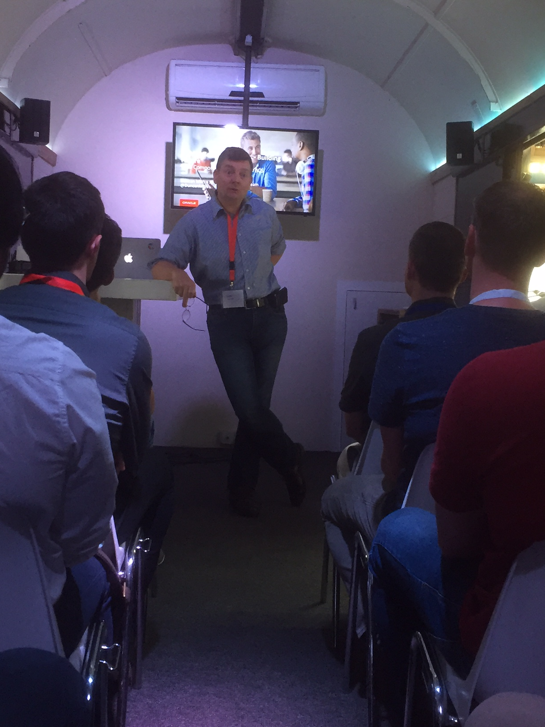
Leverage in Visual Builder Cloud

Slide 44
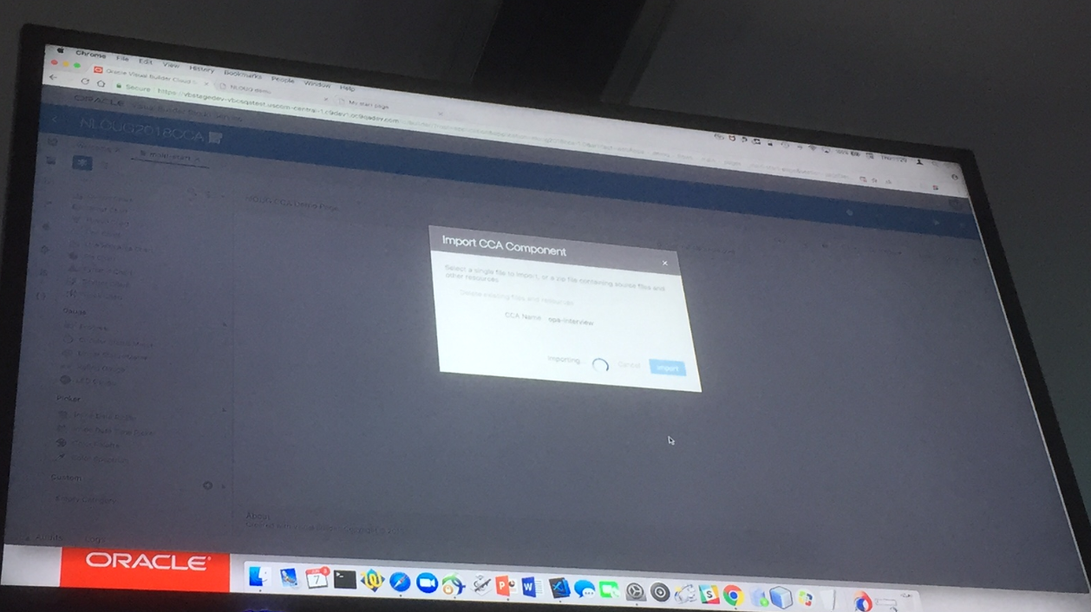
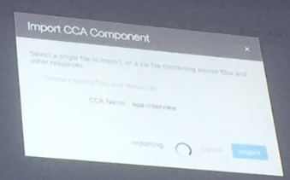
Leverage in Visual Builder Cloud

Slide 45
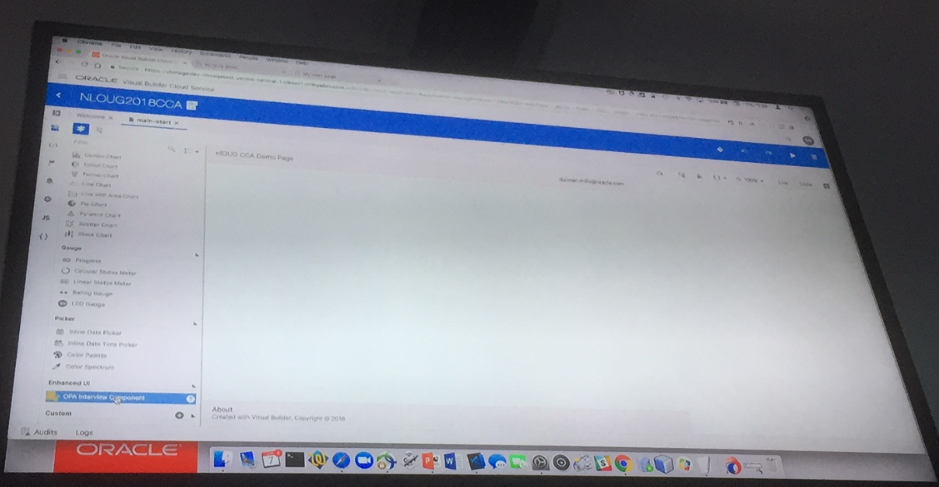
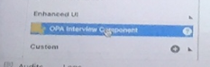
Leverage in Visual Builder Cloud

Slide 46
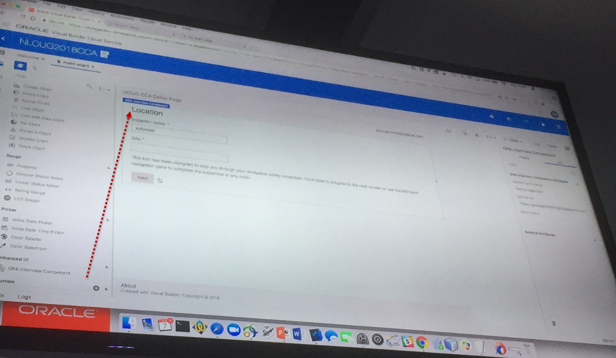
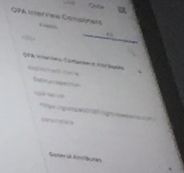
Leverage in Visual Builder Cloud

Slide 47

Summary
Components are good:
Reuse
Productivity
Clean design
Best practices
It’s like micro…
JET Composite Composite Components are straightforward
Create them like small, structured, well documented JET applications
Use them by copying a zip, configuring some properties and embedding in a view
JET Composite Components can be used in Oracle Visual Builder Cloud
I envision (or at least hope for) a world with many shared community composite components

Slide 48
Let’s Share!

Slide 49
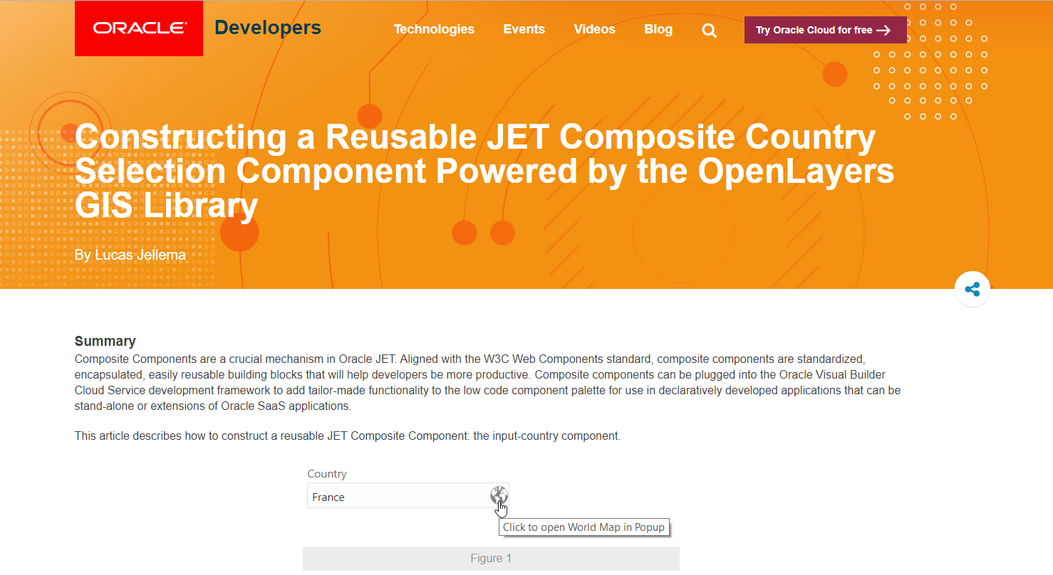
Some resources
Article: https://developer.oracle.com/javascript/reusable-jet-composite
GitHub Resources:
https://github.com/lucasjellema/jet-composite-component-showroom
https://github.com/lucasjellema/input-country-composite-component

Slide 50





Thank you Dank je wel
Blog: technology.amis.nl
Email: lucas.jellema@amis.nl
: @lucasjellema
: lucas-jellema
: www.amis.nl, info@amis.nl
https://github.com/lucasjellema/jet-composite-component-showroom
https://github.com/lucasjellema/input-country-composite-component

